Slide 1
The Impact of Social Media on Modern Communication
Revolutionizing How We Connect
Muhammad Musawar Ali Shah
10/2/2025

Slide 2
Introduction
Importance: Integral to personal, professional, and global communication.
Definition: Social media refers to online platforms for interaction, content sharing, and networking

Slide 3
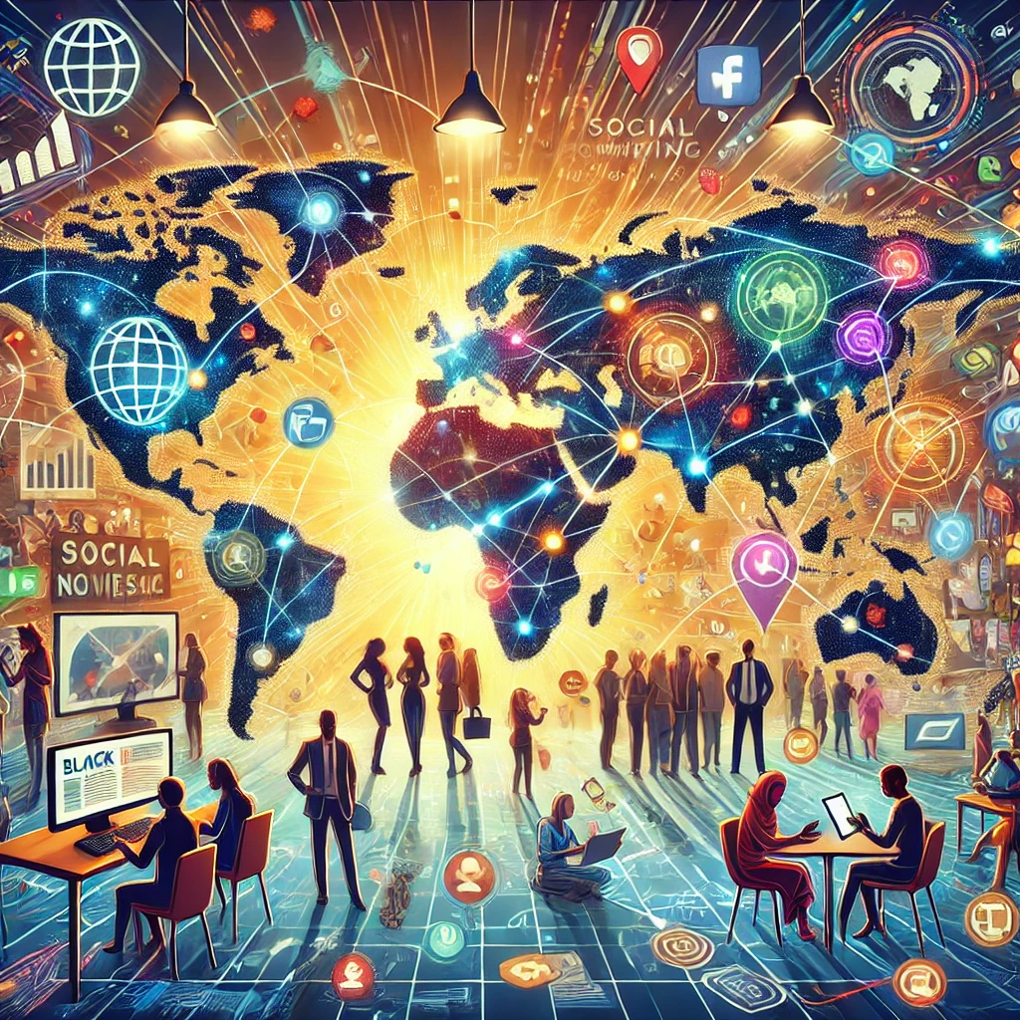
Positive Impacts
Global Connectivity
Instant connections with family, friends, and colleagues across borders.
Information Sharing
Breaking news spreads faster.
Professional Networking
LinkedIn and similar platforms aid career growth.
Social Activism
Campaigns like #FreePalestine.

Slide 4
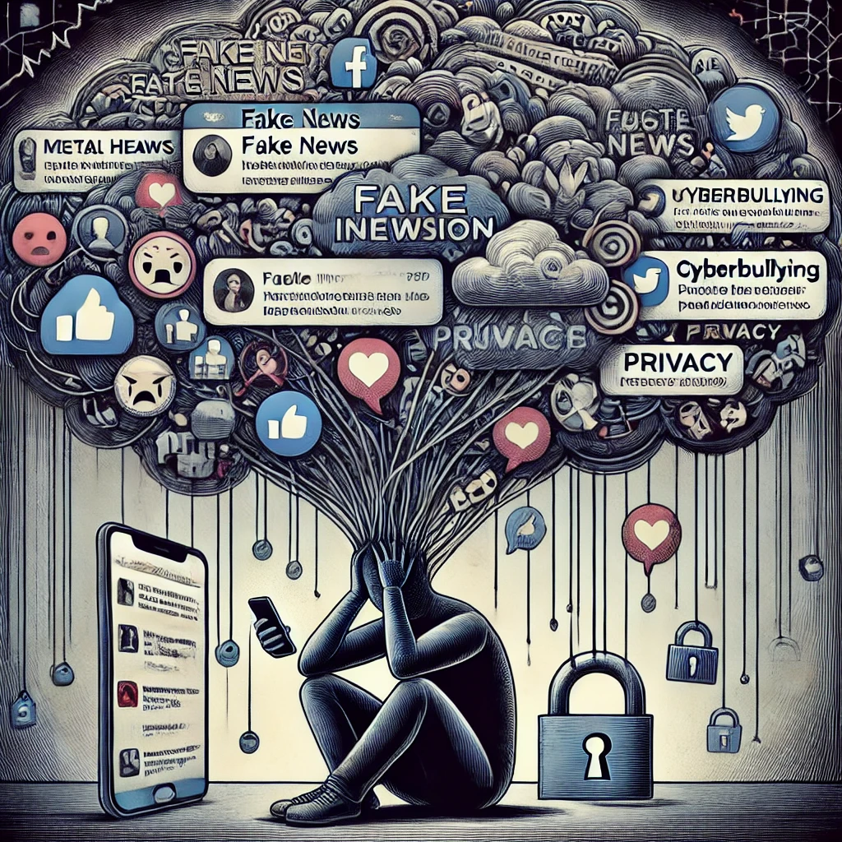
Negative Impacts
Misinformation
Fake news influences opinions and decisions.
Mental Health Issues
Comparison culture fosters anxiety and depression.
Cyberbullying
- Harassment in online spaces.
Privacy Concerns
- Data breaches and misuse of personal information.

Slide 5
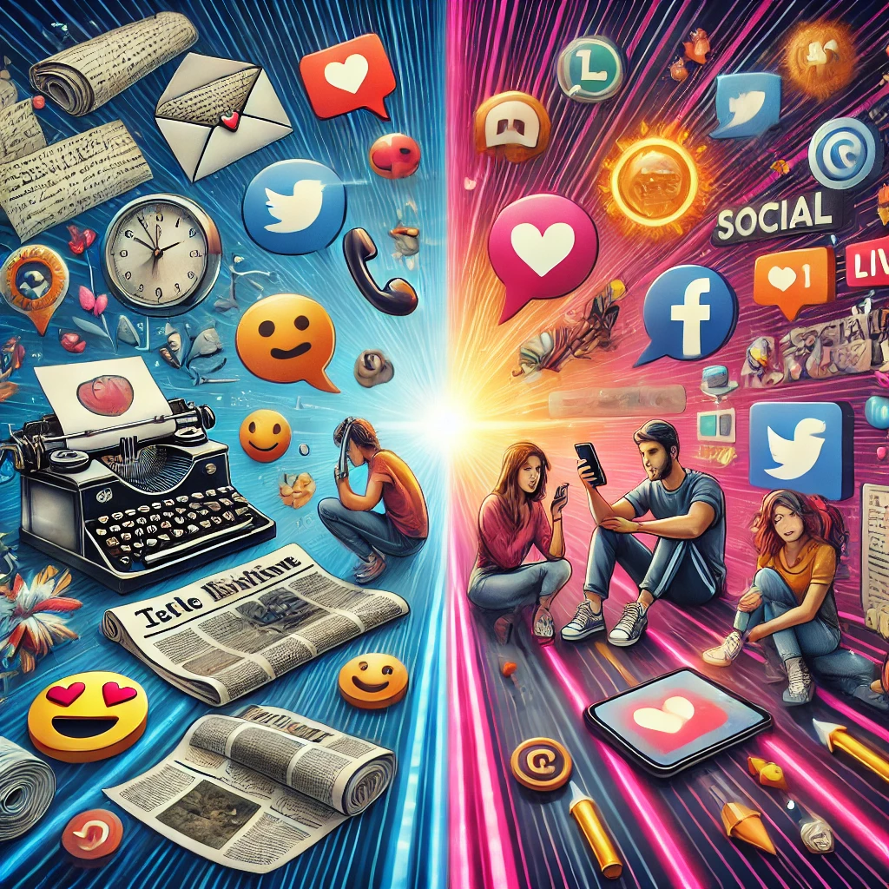
How Social Media Changed Communication
Shift from traditional (face-to-face) to digital conversations.
Use of emojis, GIFs, and memes to express emotions.
Rise of short-form content (tweets, reels, stories).
Increasing use of video calls and live streaming.

Slide 6
Statistics
Percentage of global social media users: ~60% (e.g., 4.9 billion users in 2025).
Most popular platforms: Facebook, Instagram, and TikTok.
Average time spent daily: ~2.5 hours per person.

Slide 7
Case Studies
Positive: Campaigns like #MeToo movement
Negative: Viral misinformation leading to harm

Slide 8
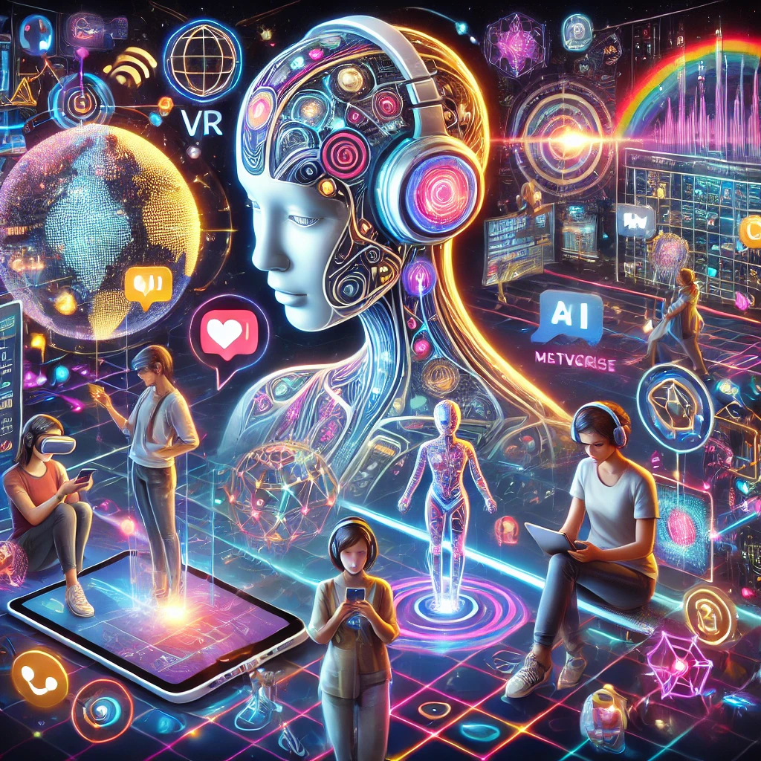
Future of Social Media in Communication
AI and Chatbots in communication
Virtual reality (VR) and the metaverse
Increasing influence of algorithms

Slide 9
THANK YOU FOR YOUR ATTENTION!

